Slide 1
Diversity, Equity and Inclusion
Notes:
AGUSTIN

Slide 2
Before…
Staff Diversity committee
Equal Employment
Opportunity Committee
College Accessibility
Committee
Academic Accommodation
Review Committee
Student gender
equity committee
ADA Committee
Notes:
AGUSTIN

Slide 3
After…
Diversity, Equity and Inclusion Council
Cuyamaca College
DEI Committee
District Services
DEI Committee
Grossmont College
DEI Committee
Notes:
AGUSTIN

Slide 4
Focus Groups
What does diversity, equity and inclusion mean to you?
How are we doing at GCCCD regarding diversity, equity and inclusion?
What are we doing well?
What do we need to be doing?
How should we communicate
about DEI?
Notes:
NANCY

Slide 5
At Home in the World
August 2011- April 2013
Notes:
AGUSTIN

Slide 6
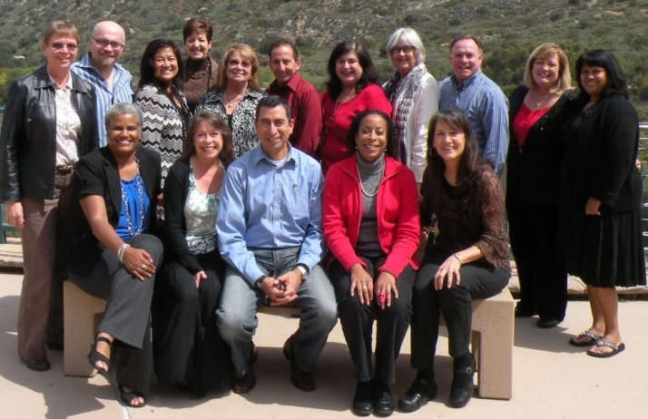
DEI Council retreat – March 2012
Notes:
AGUSTIN

Slide 7
Progress at a glacial pace
Notes:
AGUSTIN

Slide 8
A Strategic Plan
Student Access, Equity and Success
Cultural Competency and Culture of Inclusion
Communication
Developing a Diverse World-Class Workforce
Notes:
ANNE

Slide 9
Student Access, Equity
and Success
Established gender-neutral restrooms at Cuyamaca College
Established contemplation rooms at both colleges
Notes:
NANCY

Slide 10
Cultural competency
and Culture of Inclusion
Diversity Dialogues for students
Professional development workshops for staff
Notes:
NANCY

Slide 11
Created a Safe Spaces Program
for LGBT students
Notes:
NANCY

Slide 12
Communication
Wrote DEI Strategic Plan
Created DEI websites for District, Grossmont and Cuyamaca
Includes diversity activities in monthly email newsletter to community
Notes:
ANNE

Slide 13
Develop a world-class
workforce
Updated District Equal Employment Opportunity handbook
Notes:
ARLEEN

Slide 14
Notes:
ARLEEN

Slide 15
Cataloging Resources
Inventory of extant campus & district resources
Intent: non-duplication of efforts
“Piggy-back” when possible
Notes:
AGUSTIN

Slide 16
Grossmont College
DEI Committee
Agustin Albarran
Al Ventura
Carmen Fuentes
David Milroy
George Gastil
Gopa Patnaik
James Cho
Jeff Baker
Joan Ahrens
Katrina Piliaris
Nancy Davis
Narges Heidari
Peg Marcus
Roxanne Tuscany
Selam Gebrekristos
Teresa Jacob
Yolanda Guerrero
Notes:
DAVID

Slide 17
The Anatomy of Hate: A Dialogue to Hope A Michael Ramsdell Film
Grossmont College
Diversity, Equity and
Inclusion Committee
April 3, 2013
Notes:
DAVID & SELAM

Slide 18
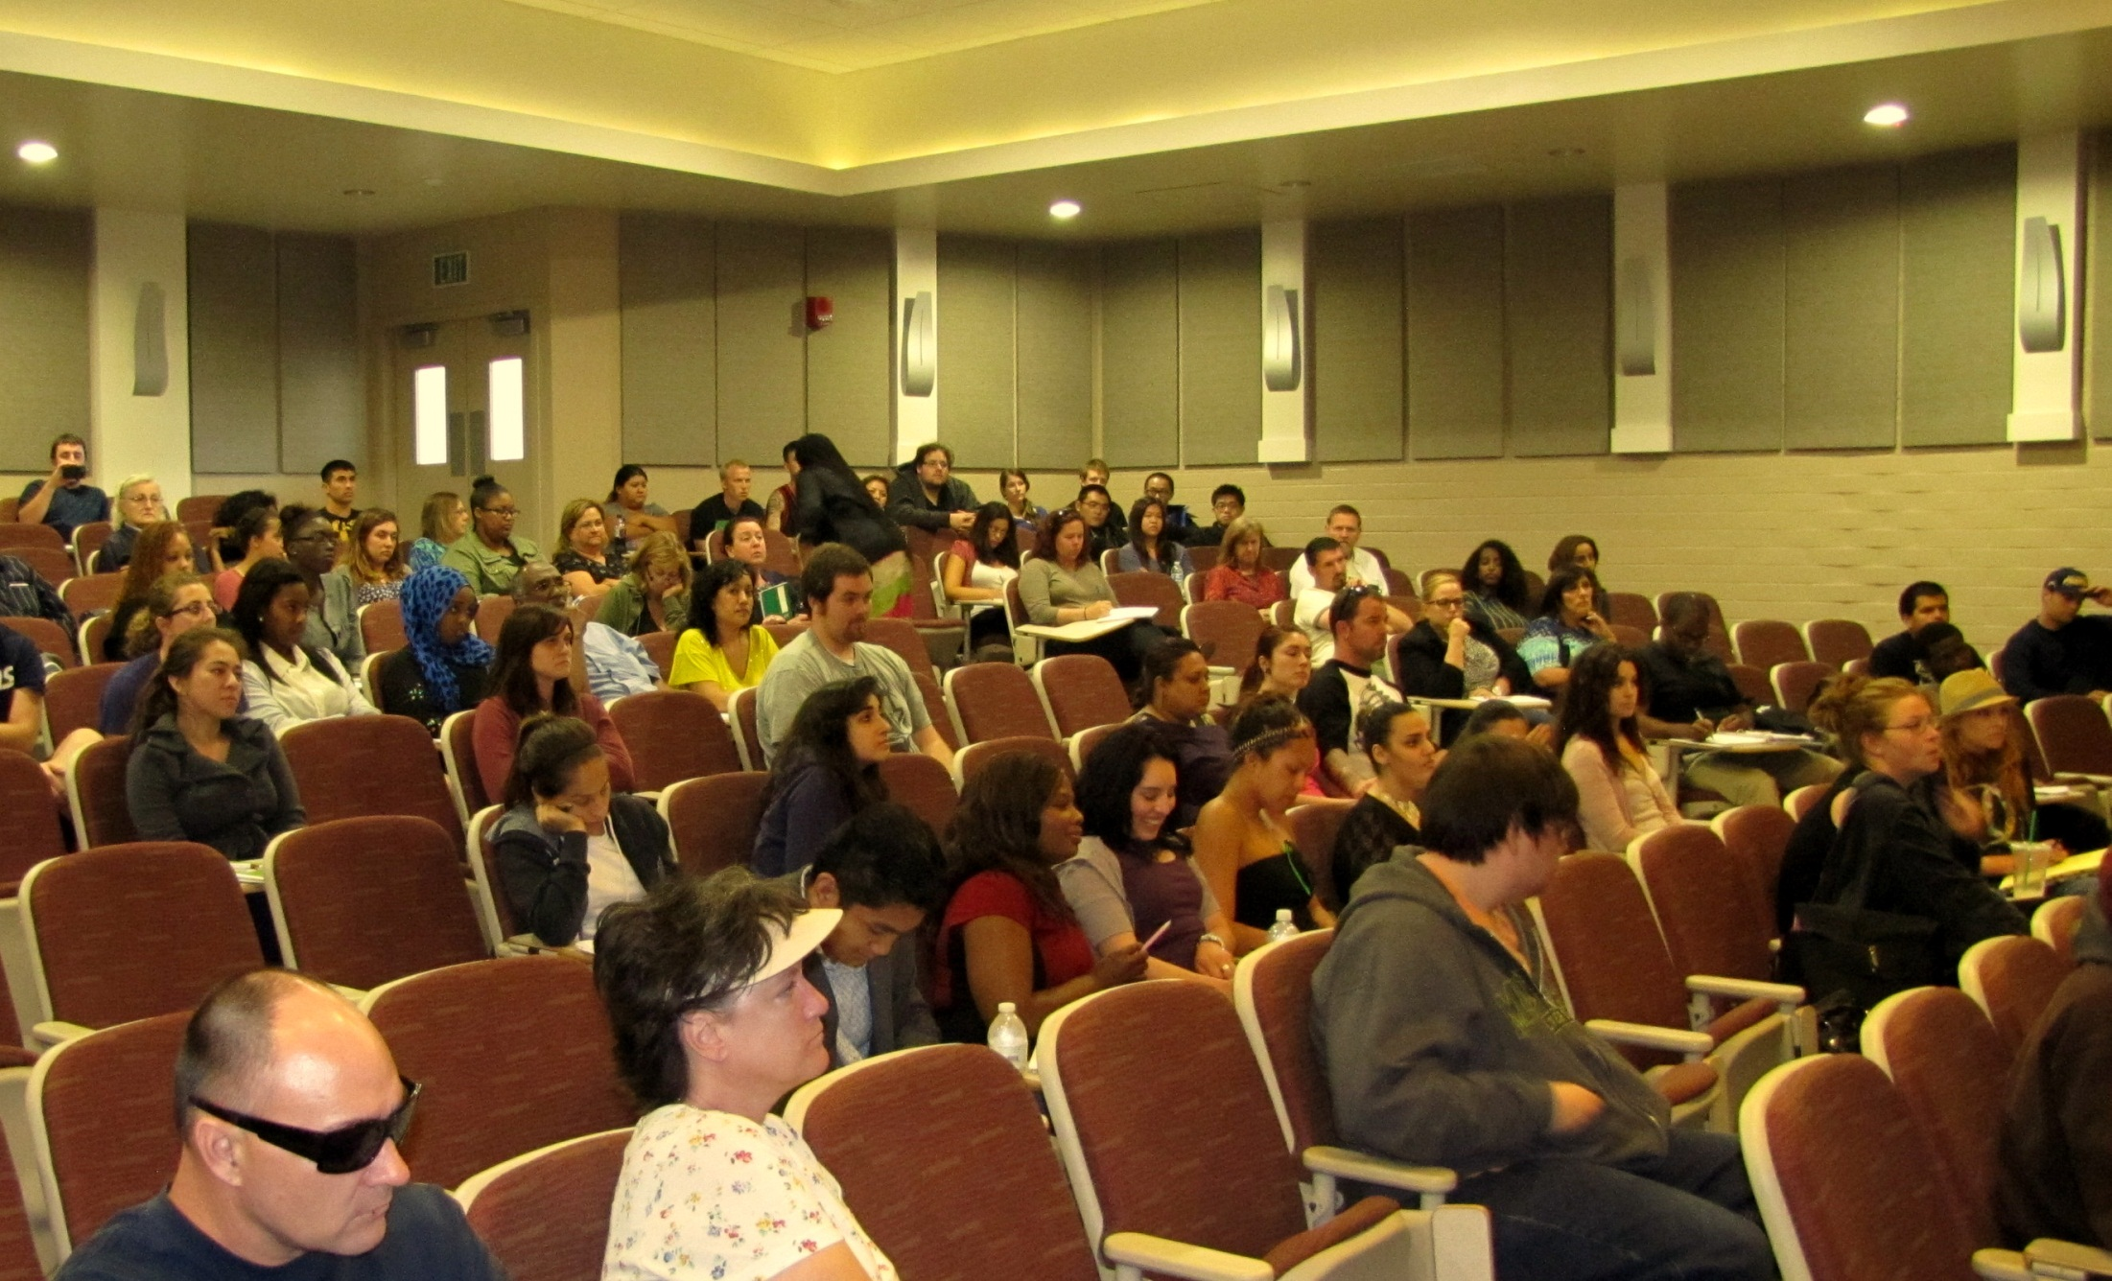
Notes:
DAVID & SELAM

Slide 19
Notes:
DAVID & SELAM

Slide 20
Notes:
DAVID & SELAM

Slide 21
Notes:
DAVID & SELAM

Slide 22
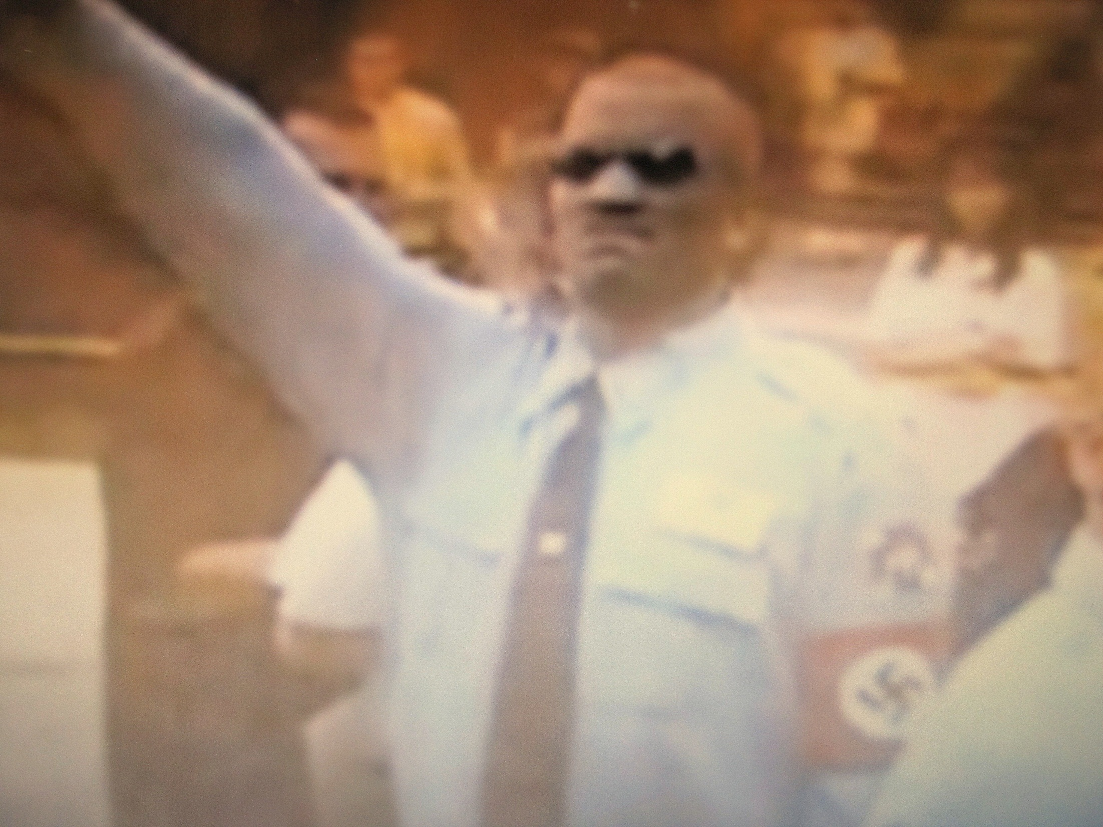
Notes:
DAVID & SELAM

Slide 23
Notes:
DAVID & SELAM

Slide 24
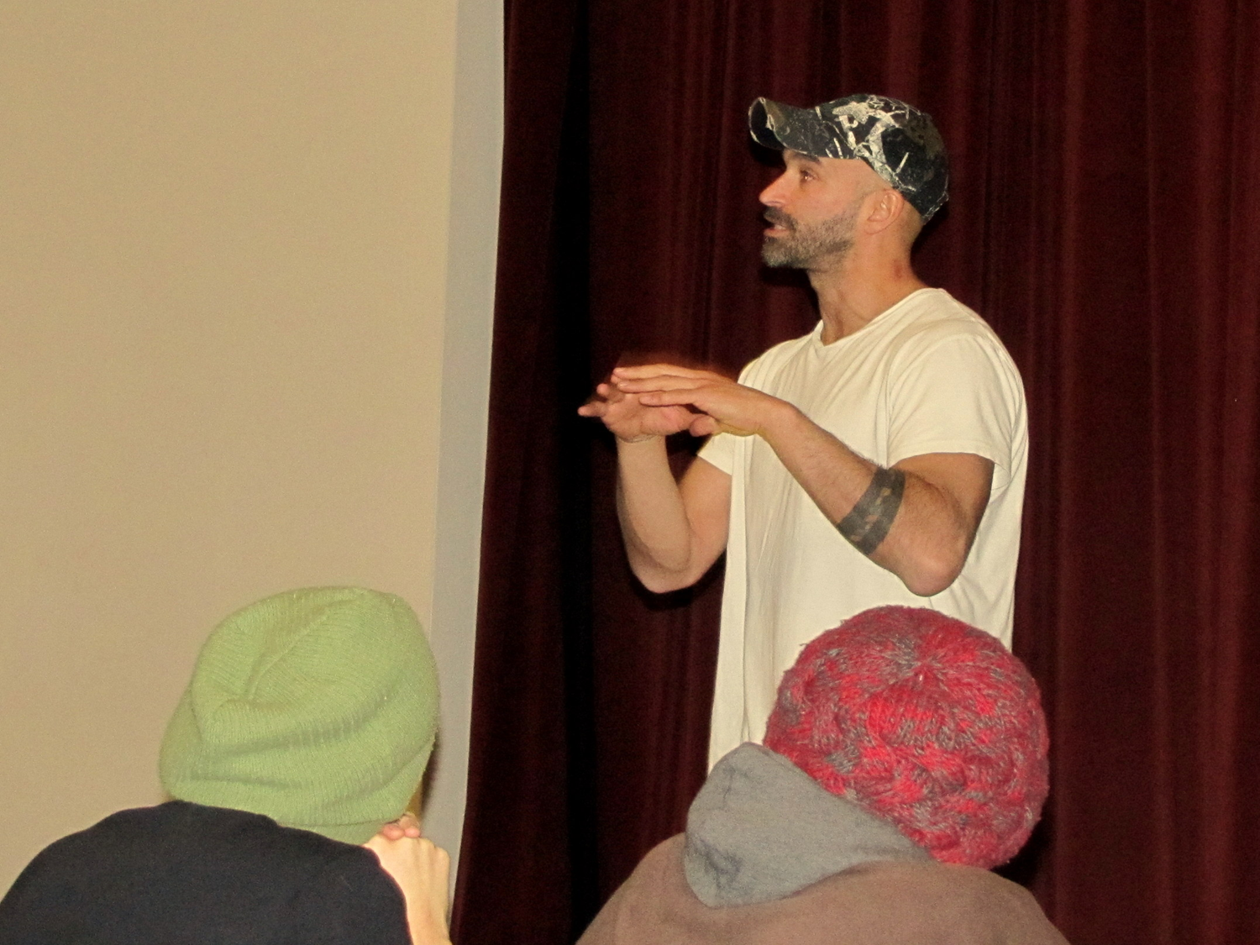
Notes:
DAVID & SELAM

Slide 25
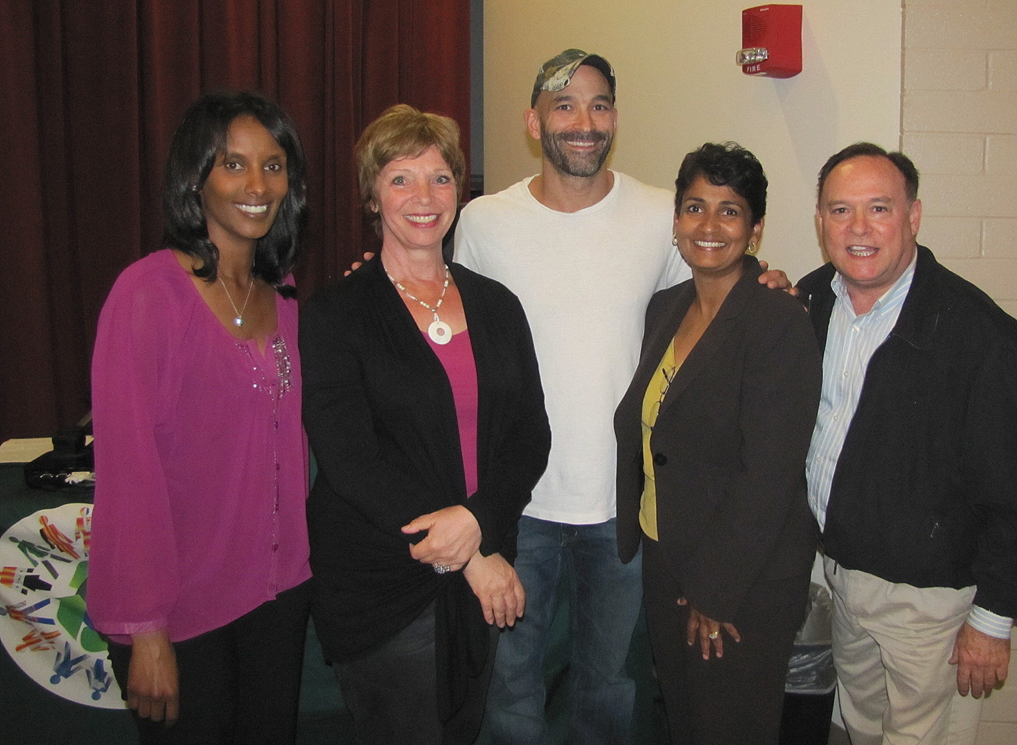
Producer/Director Mike Ramsdell at Grossmont College
Notes:
DAVID & SELAM

Slide 26
Cuyamaca College
DEI Committee
Pat Setzer
Jennifer Smith
Lauren Vaknin
Maria Gearhart
Sheryl Ashley
Jodi Reed
Raad Jerjis
Nancy Jennings
Tyson Arabo
Notes:
PAT

Slide 27
Notes:
PAT

Slide 28
Notes:
PAT

Slide 29
District Services
DEI Committee
Sue Rearic
Karen Kline
Tim Corcoran
Susan Glass
Dawn Heuft
Linda Jensen
Anne Krueger
Yvette Macy
Sandy Rosenthal
Pam Wright
Christine Yoshioka
Notes:
KAREN

Slide 30
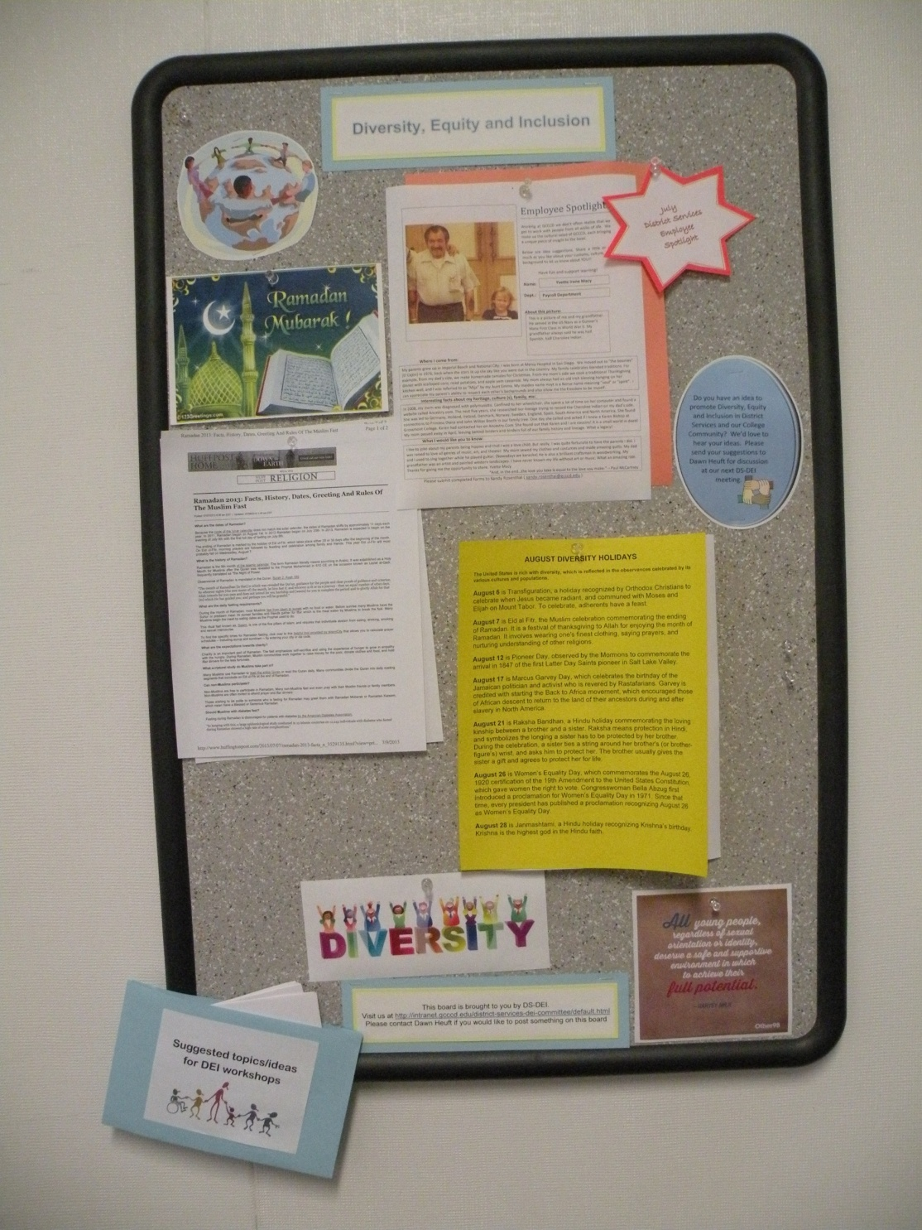
Bulletin boards in both District Services buildings highlighting
Diversity, Equity and Inclusion
Notes:
KAREN

Slide 31
Notes:
KAREN

Slide 32
Next STEPS
Identify and promote diversity in the curriculum
Include diversity in new employee onboarding
Create a diversity leadership award at sites/district
Hold workshop on diversity language
Notes:
AGUSTIN

Slide 33
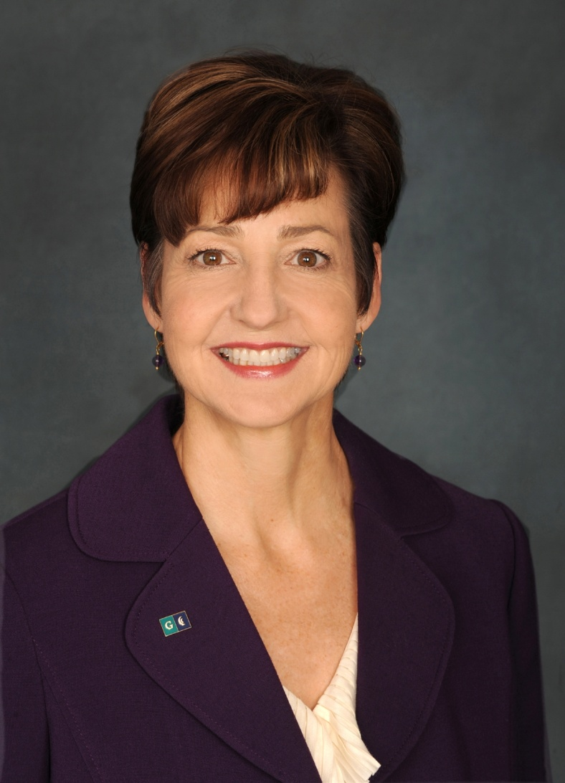
THANK YOU, DR. MILES
Notes:
AGUSTIN– at conclusion, have reps from GC (David Milroy), CC (Pat Setzer) and DS (Karen Klein) talk briefly about their accomplishments.
20-minute exercise with Raad

